Slide 1
Graphs and Trees

Slide 2
Objectives for today
Improve your ability to choose and justify a great data structure by:
Describing graph and tree abstract data types accurately in terms of key terminology
Explaining what is special about trees compared to graphs
Implementing and describing traversal algorithms for graphs and trees
Recommending a graph or a tree for a given scenario

Slide 3
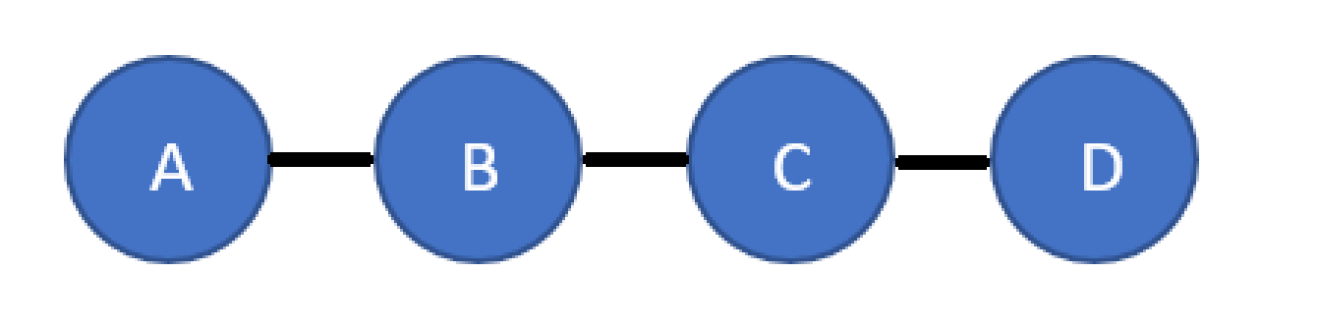
Visualisation of some data
Could be represented in a program in more than one way. Such as…

Slide 4
Visualisation of some data
What influences our choice?

Slide 5
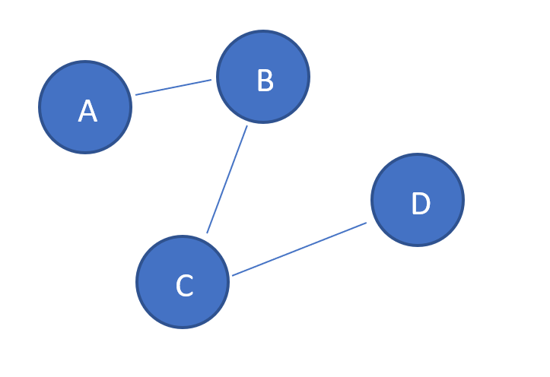
A graph
Draw this graph on some paper.
Label nodes and edges.
How many nodes?
How many edges?
This graph is quite sparsely connected…
Add a new edge connecting A and C directly
Add a new node, E, adjacent to D and with D as its only neighbour

Slide 6
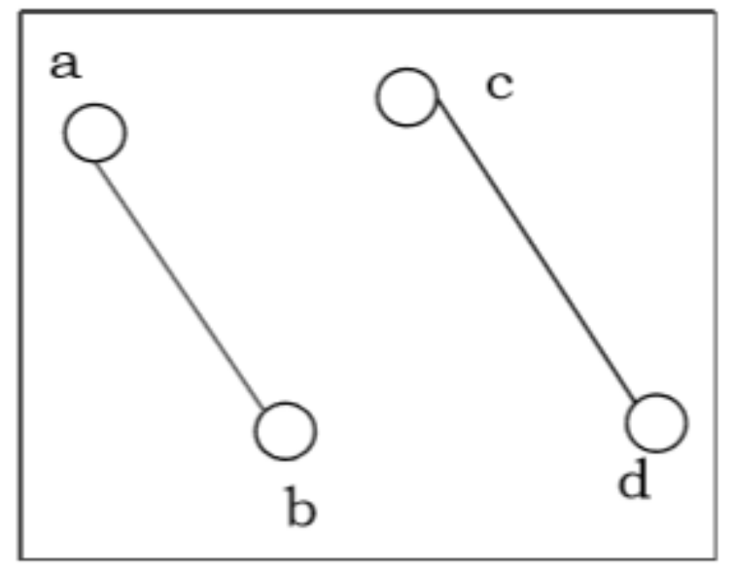
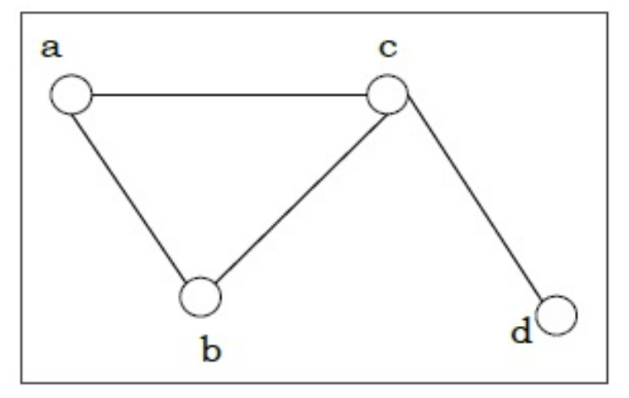
Levels of connectedness
Disconnected
Connected
Fully connected

Slide 7
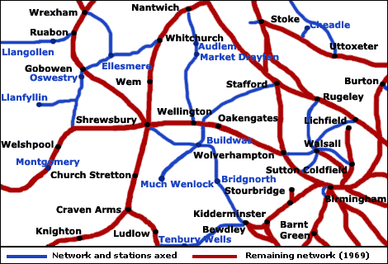
Levels of connectedness Example 1…

Slide 8
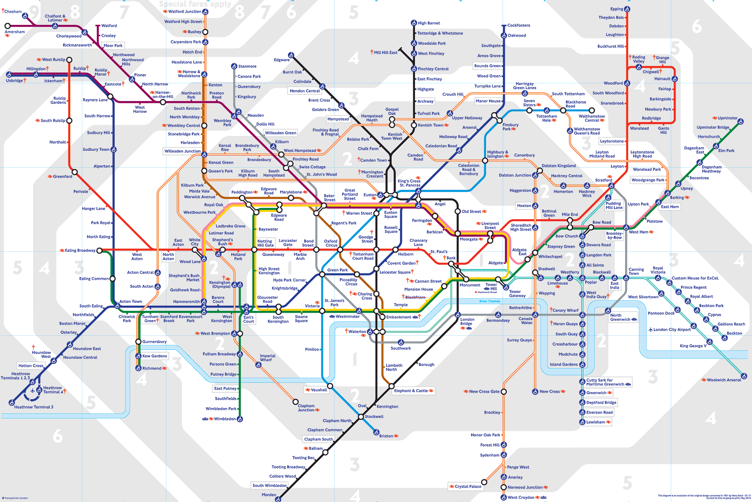
More densely connected graphs have more paths between pairs of nodes.
Parts of central London are quite densely connected by the tube.
That’s why you can take various paths between Euston and Oxford Circus.
In infrastructure such as the tube or the internet, what would be one advantage and one disadvantage of being more densely connected?

Slide 10
Please complete the questions on graphs on
your handout…
Time: 6 ½ minutes

Slide 11

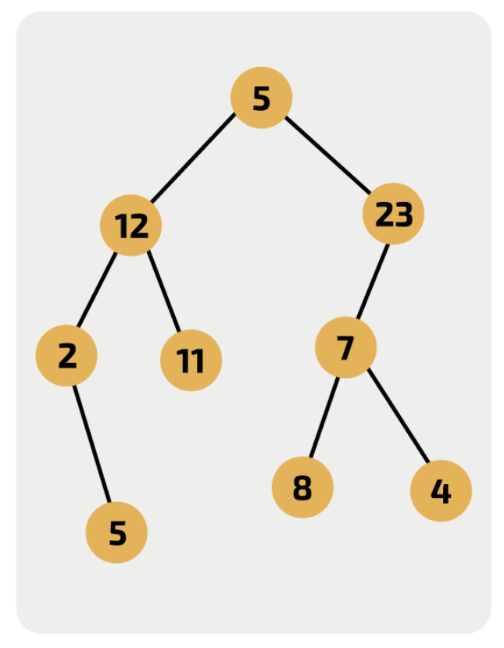
A special graph…
This graph can be called a tree
but why also a graph?
Terminology:
Root/branch/leaf
Parent/child/sibling
A tree has hierarchy
i.e. is hierarchical
Has no cycles in ever

Slide 12
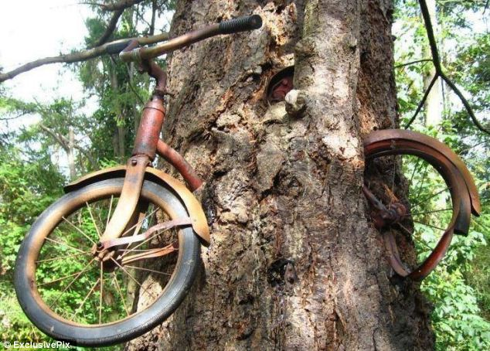
This is not OK
NO

Slide 13
Trees
A leaf node has no…
Children
A root node has no…
Parent
Draw the tree and then answer these questions:
State any root nodes
State any leaf nodes
Why can there be no branch between 4 and 8?
Can we write an algorithm to navigate to the root node from currentNode?
Now please complete the trees section of the handout

Slide 14
Traversals
A traversal just means exploring every node
There are different algorithms to do that
Breadth first
Depth first
In a tree we always start at the root
(In other graphs you’ll be given a start node)
The different traversals just say which routes to explore first

Slide 15
Breadth-first traversal
The algorithm:
Do:
Output(currentNode)
For each child of current node
Enqueue to needingVisiting //*TRACE POINT
currentNode = dequeue from needingVisiting
Until currentNode == null
The effect:
You move one generation further from start node each time and list all the nodes at that search depth
With a tree it’s like reading a book
FYI these traversals also work on graphs, with slight tweaks of language. Extension: write algos

Slide 16
Depth-first traversal
output currentNode
push currentNode to stack
While stack not empty
If currentNode has unvisited child
currentNode = next unvisited child
else
//backtrack
stack.pop
currentNode = stack.peek
continue
stack.push currentNode
output currentNode
Outputting nodes as you first visit them, traverse down unvisited nodes until you hit a leaf, then backtrack until you can find another unvisited route downwards
Assume left branch comes before right
BACKTRACK WHEN YOU CAN’T GO DOWN ANY MORE

Slide 17
Tasks
output currentNode
push currentNode to stack
While stack not empty
If currentNode has unvisited child
currentNode = next unvisited child
else
//backtrack
stack.pop
currentNode = stack.peek
continue
stack.push currentNode
output currentNode
Have a go at the tree traversals practice activity (9 mins)
Then we’ll go over them
Next is the breadth-first algorithm training exercises

Slide 18
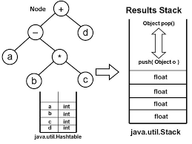
Applications of trees

Slide 19
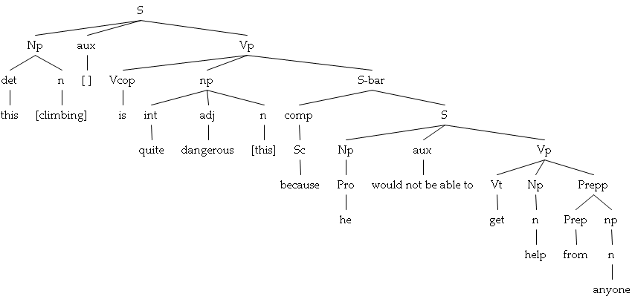
Notes:
A quick slideshow of some applications to stimulate imaginations

Slide 20
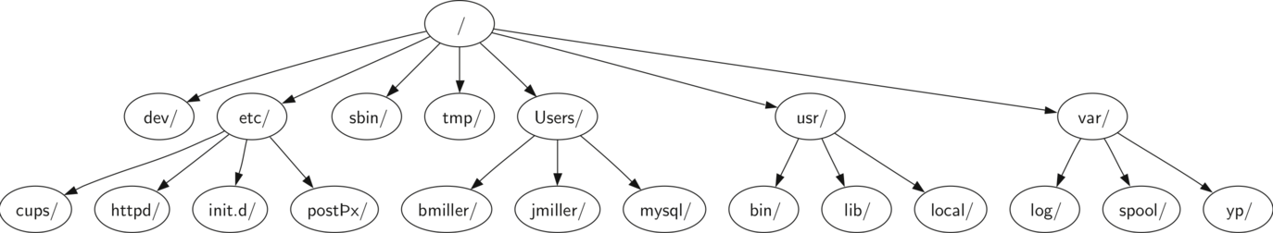
Filesystem

Slide 21
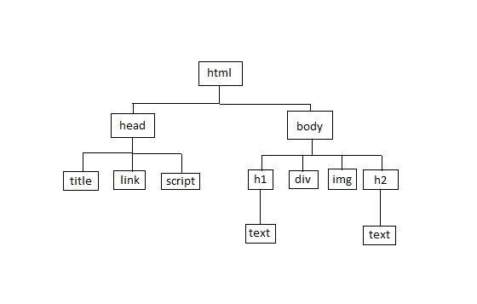

Slide 22
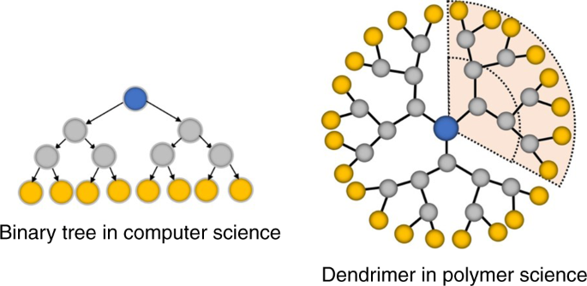

Slide 23
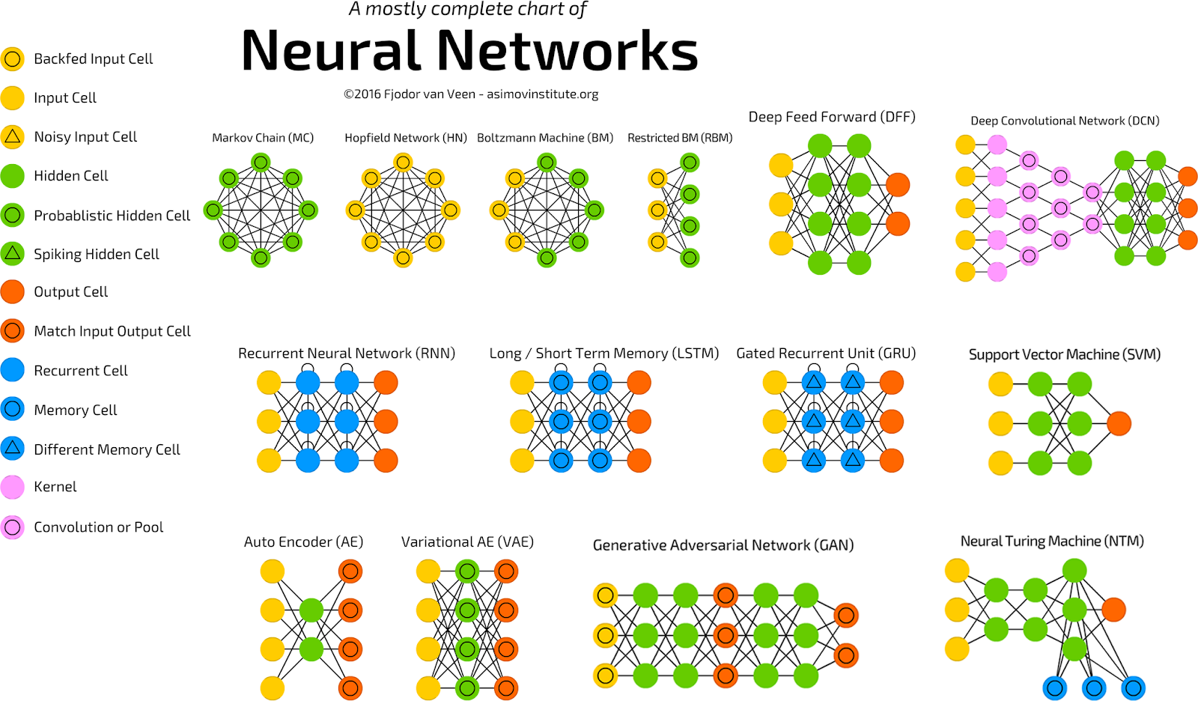

Slide 24
